Slide 1




Slide 2

Test Time on Odd Even Linked List
URL : https://forms.gle/6qqVmGx9RoDy4Sjw9

Slide 3

Swapping Nodes in a
Linked List

Slide 4
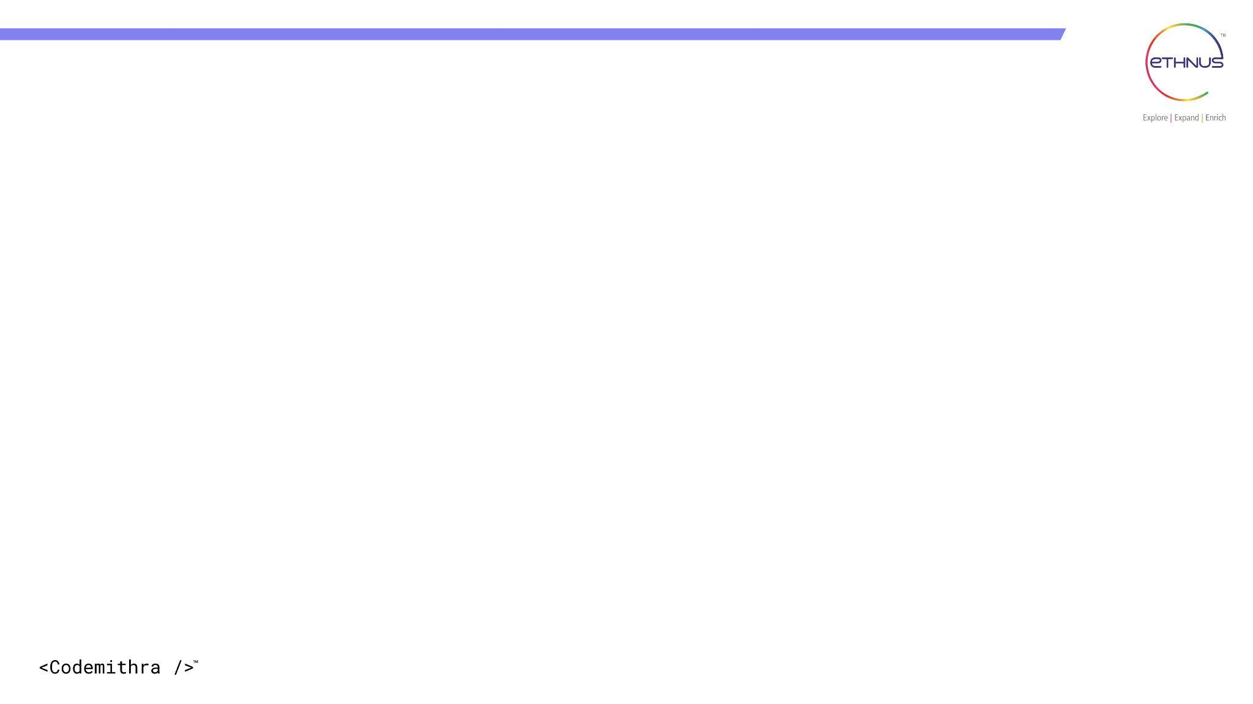

TOPICS
Introduction
Algorithm Pseudocode
Example
Code
Time and space complexity
Advantages and disadvantages
Interview Questions

Slide 5
Swapping Nodes in a Linked List
The Objective
Given a linked list and an integer k.
The Task: Swap the values of the k-th node from the beginning and the k-th node from the end.
Key Constraint: The indexing is usually 1-based.
Real-World Interview Context
Recency: Highly active in 2024-2026 problem sets.
LeetCode 1721
Amazon (SDE-1 Virtual Onsite)January 18, 2025

Slide 6
Algorithm :
To solve this efficiently in one pass ($O(n)$ time), we use three specific pointers:
The First Node (first): Find the k-th node from the start by moving k-1 steps from the head.
The Fast Pointer (fast): Start this at the first node.
The Second Node (second): Start this at the head.
The Logic:
Move fast and second forward together until fast reaches the last node. When fast hits the end, the second pointer will be exactly at the k-th node from the end.

Slide 7
Algorithm Steps
Step 1: Locate the Start K-th Node
Initialize a pointer curr at the head.
Move it k-1 times.
Store this position as first.
Step 2: Locate the End K-th Node
Set fast = first.
Set second = head.
While fast.next is not null:
Move both fast and second forward by one.
The second pointer is now your target from the end.
Step 3: The Value Swap
Swap the data: temp = first.val; first.val = second.val; second.val = temp;
Note: We swap values, not the actual node connections, which makes the implementation much simpler!

Slide 8
Pseudocode:
Function swapNodes(head, k):
If head is null:
Return null
length = 0
temp = head
While temp is not null:
length = length + 1
temp = temp.next
first = head
for i = 1 to k - 1:
first = first.next
second = head
for i = 1 to (length - k):
second = second.next
tempData = first.data
first.data = second.data
second.data = tempData
Return head
Notes:
Function swapNodes(head, k):
If head is null:
Return null
// Step 1: Count total nodes
length = 0
temp = head
While temp is not null:
length = length + 1
temp = temp.next
// Step 2: Find the kth node from start and kth from end
first = head
for i = 1 to k - 1:
first = first.next
second = head
for i = 1 to (length - k):
second = second.next
// Step 3: Swap their data
tempData = first.data
first.data = second.data
second.data = tempData
Return head

Slide 9
Example:
Input Linked List:
1 → 2 → 3 → 4 → 5
k = 2
Output Linked List:
1 → 4 → 3 → 2 → 5
Step-by-Step Explanation:
Find list length:
Total nodes = 5
Identify nodes to swap:
k-th from start = 2nd node → value = 2
k-th from end = (5 - 2 + 1) = 4th node → value = 4
Swap their values:
Swap 2 and 4
List becomes:
1 → 4 → 3 → 2 → 5

Slide 10
import java.util.Scanner;
class Node {
int data;
Node next;
Node(int data) {
this.data = data;
this.next = null;
}
}
public class SwapNodesLinkedList {
static Node insert(Node head, int data) {
Node newNode = new Node(data);
if (head == null) return newNode;
Node temp = head;
while (temp.next != null)
temp = temp.next;
temp.next = newNode;
return head;
}
static Node swapNodes(Node head, int k) {
if (head == null) return null;
int length = 0;
Node temp = head;
while (temp != null) {
length++;
temp = temp.next;
}
Node first = head;
for (int i = 1; i < k; i++)
first = first.next;
Node second = head;
for (int i = 1; i < length - k + 1; i++)
second = second.next;
int tempData = first.data;
first.data = second.data;
second.data = tempData;
return head;
}
Notes:
import java.util.Scanner;
class Node {
int data;
Node next;
Node(int data) {
this.data = data;
this.next = null;
}
}
public class SwapNodesLinkedList {
// Insert node at the end
static Node insert(Node head, int data) {
Node newNode = new Node(data);
if (head == null) return newNode;
Node temp = head;
while (temp.next != null)
temp = temp.next;
temp.next = newNode;
return head;
}
// Swap k-th node from start and end
static Node swapNodes(Node head, int k) {
if (head == null) return null;
// Step 1: Count total number of nodes
int length = 0;
Node temp = head;
while (temp != null) {
length++;
temp = temp.next;
}
// Step 2: Find k-th node from start
Node first = head;
for (int i = 1; i < k; i++)
first = first.next;
// Step 3: Find k-th node from end (position = length - k + 1)
Node second = head;
for (int i = 1; i < length - k + 1; i++)
second = second.next;
// Step 4: Swap their data
int tempData = first.data;
first.data = second.data;
second.data = tempData;
return head;
}
// Print the linked list
static void printList(Node head) {
Node temp = head;
while (temp != null) {
System.out.print(temp.data + " ");
temp = temp.next;
}
System.out.println();
}
// Main method
public static void main(String[] args) {
Scanner sc = new Scanner(System.in);
Node head = null;
System.out.print("Enter number of nodes: ");
int n = sc.nextInt();
System.out.println("Enter " + n + " elements:");
for (int i = 0; i < n; i++) {
int val = sc.nextInt();
head = insert(head, val);
}
System.out.print("Enter the value of k: ");
int k = sc.nextInt();
System.out.print("Original List: ");
printList(head);
head = swapNodes(head, k);
System.out.print("After Swapping k-th node from start and end: ");
printList(head);
}
}

Slide 11
static void printList(Node head) {
Node temp = head;
while (temp != null) {
System.out.print(temp.data + " ");
temp = temp.next;
}
System.out.println();
}
public static void main(String[] args) {
Scanner sc = new Scanner(System.in);
Node head = null;
System.out.print("Enter number of nodes: ");
int n = sc.nextInt();
System.out.println("Enter " + n + " elements:");
for (int i = 0; i < n; i++) {
int val = sc.nextInt();
head = insert(head, val);
}
System.out.print("Enter the value of k: ");
int k = sc.nextInt();
System.out.print("Original List: ");
printList(head);
head = swapNodes(head, k);
System.out.print("After Swapping k-th node from start and end: ");
printList(head);
}
}

Slide 12
Code Explanation
Node class:
Represents each node in the list with data and next.
insert():
Adds a new node at the end of the list.
swapNodes():
Counts the total number of nodes using a loop.
Finds the k-th node from start using a for loop.
Finds the k-th node from end using the formula: length - k + 1
Swaps their data values using a temporary variable.
printList():
Traverses and prints each node in the list.

Slide 13
main():
Takes input from the user for list size and elements.
Accepts value of k.
Displays the original list and the modified list after swapping.
Sample Input:
Enter number of nodes: 5
Enter 5 elements:
1 2 3 4 5
Enter the value of k: 2
Output:
Original List: 1 2 3 4 5
After Swapping k-th node from start and end: 1 4 3 2 5

Slide 14
Time Complexity: O(n)
First traversal → To count the total number of nodes (n):
Requires visiting each node once → O(n)
Second traversal → To locate:
k-th node from start, and
k-th node from end (at position n - k + 1)
Each traversal is up to O(n) in the worst case, but together still O(n)
Swapping values between two nodes takes O(1) time
Total Time = O(n) + O(n) + O(1) = O(n)
Space Complexity: O(1)
Only a constant number of variables and pointers are used:
For example: first, second, temp, and counters like length and i
No recursion, no arrays or additional data structures
So space used is constant, i.e., O(1)

Slide 15
Advantages :
Simple and Efficient (When Swapping Values):
Swapping the values (data fields) is straightforward and avoids complex pointer manipulations.
Runs in O(n) time and O(1) space.
Preserves List Structure:
Node links remain intact (especially when swapping data), reducing the risk of breaking the list.
No Extra Memory Needed:
The operation is done in-place with only a few temporary variables.
Works for Any Valid k:
Can handle any valid position k, including symmetric positions like middle and ends.

Slide 16
Disadvantages :
Only Swapping Values (Not Actual Nodes):
In some cases (e.g., when data must not be modified), swapping nodes (not values) is required, which is more complex.
Requires Full Traversal Twice:
One pass to find the length, another to locate target nodes → still O(n) but with 2 traversals.
Error-Prone When k is Invalid:
If k is less than 1 or greater than the list length, it may cause null pointer errors if not handled properly.
Less Useful in Doubly Linked List Cases:
In doubly linked lists, swapping actual nodes is preferred and more efficient due to backward traversal.
Not Suitable for Data-Restricted Nodes:
In some real-world cases (e.g., secure data), values cannot be swapped directly.

Slide 17
QUESTION 1
How do you find the k-th node from the end in a singly linked list?
Answer:
Use the formula:
Position from start = (length - k + 1)
Since singly linked lists can't go backward, you must first traverse the list to find its length.

Slide 18
QUESTION 2
Why do we usually swap values instead of actual nodes?
Answer:
Swapping node values is easier and avoids breaking or fixing next pointers, especially in a singly linked list.
Swapping nodes requires handling edge cases like adjacent nodes, head/tail changes, etc.

Slide 19
QUESTION 3
What edge cases would you consider when swapping nodes?
Answer:
k is 1 (swap head and tail)
k equals length/2 (swapping the same node — no change)
k is greater than list size (invalid — should handle gracefully)
List is empty or has only 1 node (nothing to swap)

Slide 20
QUESTION 4
How would you test your swap function?
Answer:
Odd/even number of nodes
k = 1, k = length, k = length/2
Edge cases (empty list, 1-node list, invalid k)

Slide 21


Help Desk
Any concerns related to attendance/marks/ faculty ; you can reach out to ETHNUS helpdesk through the displayed QR code
https://codemithra.com/vit-helpdesk/

Slide 22

https://learn.codemithra.com

Slide 23




THANK YOU
+91 78150 95095
codemithra@ethnus.com
www.codemithra.com

